Slide 1


Peer Support
Patricia Folcarelli RN, PhD,
Interim VP Health Care Quality, BIDMC
pfolcare@bidmc.harvard.edu

Slide 2
Leadership Team
Developed in late 2013
Multidisciplinary team
  Sr. VP HR
  CQO
  Associate Chief Nurse
  Sr. Director Patient Safety
  Psychiatric Clinical Specialists
  Psychiatry/Clinician Health
  Nurse Managers
  Physicians
  Clinical Director, Social Work
  Project Management
Notes:
Pat

Slide 3
Recruitment
A BIDMC team has come together to help create a culture that emphasizes peer support. We are beginning a pilot peer support program that will be rolled out in the ICUs, the Operating Rooms, and Labor and Delivery, and, after the pilot, we hope to spread the program throughout the medical center. To help us get this program off the ground, we ask that you help us simply by identifying a peer in your environment that you think may be helpful in a difficult situation (this is voluntary for the nominees). This survey is anonymous, and will close April 1, 2013.
Notes:
Work with nursing directors and chiefs to send an Email sent with link to survey staff to nominate someone that they would go to for support following a stressful event. Typically we would see people who naturally lend an ear and offer support to

Slide 4
Peer Supporter Expectations
Attend a 3.5 hour training
Participate in email check-ins
  “I reached out to a coworker last week whose dad is ill. I don't know if it’s like this in other professions but I feel like nurse's always feel like we need to take care of others and sometimes forget we need to take care of ourselves. I encouraged her to contact EAP and look into the family leave act.”
Attend bi-annual gatherings
  Hone their skills, debrief, and support one another in the important work they are doing.
Notes:
Lisa

Slide 5
Current Program
1:1 Peer to Peer model
135 Peer Supporters in all inpatient units, dermatology, pharmacy, radiology and HCA
Includes non-patient facing units (i.e., the blood bank and pathology)
Program includes attendings, residents, fellows, nurses, PT/Ots, unit-based coordinators & techs
Notes:
Ancillary units

Slide 6
Peer Supporter Role Description
What a Peer Supporter Does | What a Peer Supporter Does NOT Do
Normalizes feelings of peer | Participate in Quality Assurance, RCAs
Validates competence of peer | Offer disclosure coaching (there are other resources for this: page 3-HELP)
Assesses peer’s need for professional resources | Deal with job performance issues
Directs peer to other resources as appropriate | Handle substance abuse coaching or violence prevention
Follows up with peer in the short term and long term to “check-in” | Offer malpractice suit support (there are other resources for this)
Notes:
What is the role of the peer supporter?

Slide 7
BIDMC Peer Support
Health Services
Clinician Health Service
Employee Assistance Program
Chaplains, Social Work, etc.
(the above can also give external referrals)
Peer Supporters
Give one-on-one support
Aware of all other support services offered at BIDMC and gives information about those resources as appropriate
Aware of self-harm escalation criteria
Upsetting event occurs
Affected individuals identified
Peer supporters approach affected individuals, or vice versa
Notes:
This is the process for a peer support interaction.

Slide 8
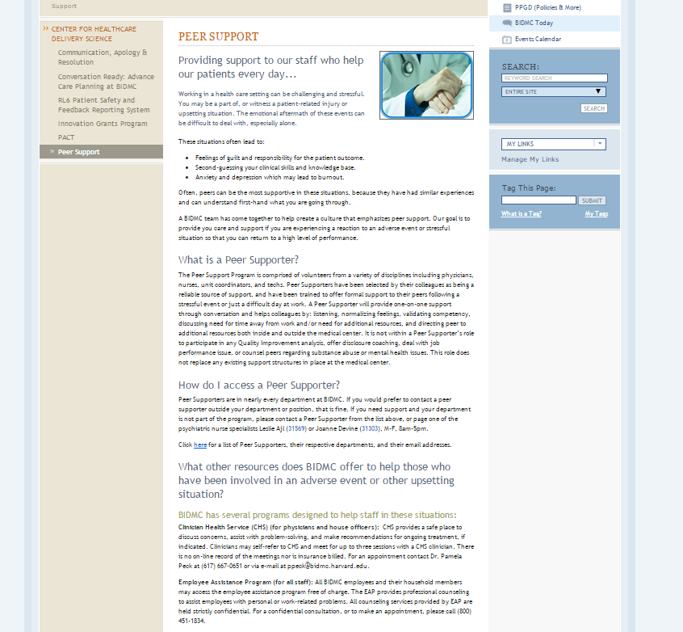
Peer Support Portal Page
Notes:
Lisa

Slide 9
Notes:
Lisa

Slide 10
Notes:
Lisa

Slide 11
Evaluating the Program
Survey staff of pilot units
  Have you experienced an adverse event?
  Do you know about the Peer Support Program?
  Have you used the program?
  If yes, was it helpful? If not, why not?
  Do you know who the Peer Supporter is in your area?
Notes:
Lisa

Slide 12
Survey Results
  251 respondents – physicians, nurses, and techs
  90% staff surveyed experienced event in last 12 months
  Top 3 causes of stress - communication breakdown, adverse event and patient death
  30% did not seek support following event
  1/3 received support from colleague or peer supporter
  50% aware of BIDMC Peer Support program
Can peer support make it easier to cope with emotional reactions to events? 70% yes
Do you believe it can improve job performance and satisfaction? 70% yes

